Slide 1


Resting-state fMRI: Principles, Data Analyses and Applications to Cognitive Science and Brain Disorders
严超赣
Chao-Gan Yan, Ph.D.
yancg@psych.ac.cn
http://rfmri.org/yan
Institute of Psychology, Chinese Academy of Sciences

Slide 2
Outline
Resting-State fMRI: Principles
Data Analysis: Computational Algorithms
Data Analysis: Methodological Issues
Data Analysis: Computational Platform
Applications to Cognitive Science
Applications to Brain Disorders
2

Slide 3
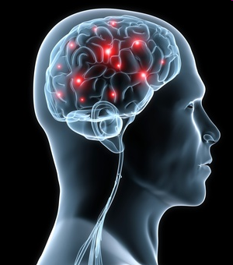
Resting-State fMRI: Principles
All of the human high mental functions such as thinking, emotion and consciousness rely on brain, an extremely complex system (Singer, 1999)
http://psychcentral.com/news/2010/11/03/new-insights-on-brains-internal-wiring/20500.html
3

Slide 4
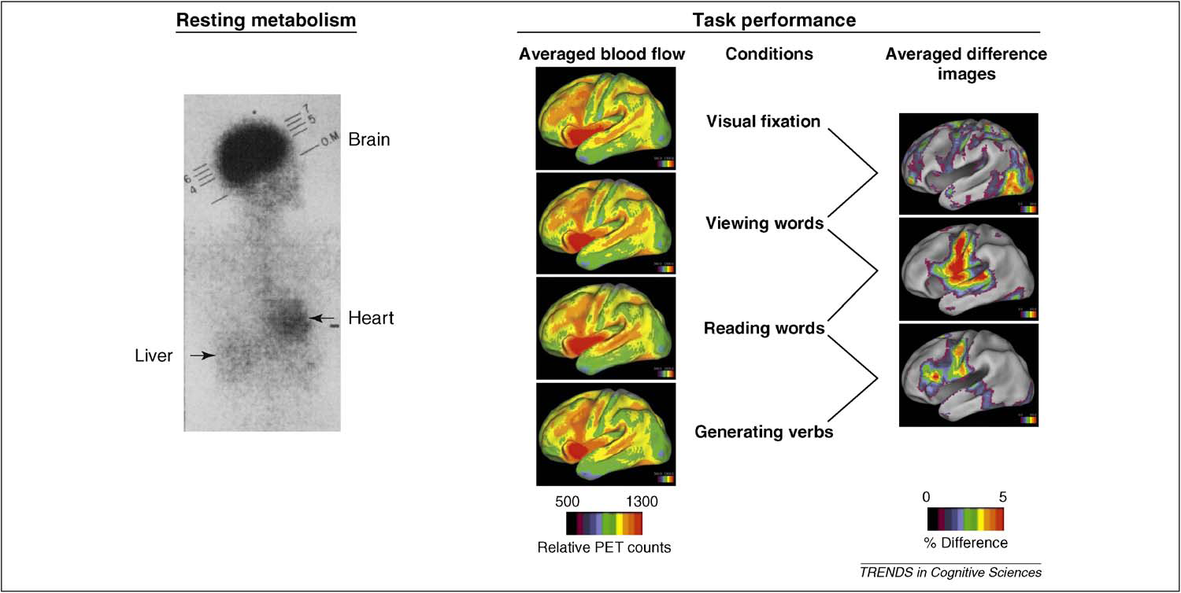
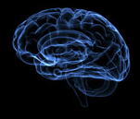
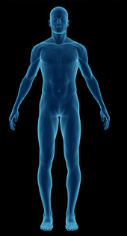
Resting-State fMRI: Principles
Weight
Cardiac output
Glucose consumption
2%
11%
20%
Raichle et al., 2010. Trends Cogn Sci
4

Slide 5
Resting-State fMRI: Principles
Task evoked increases
Resting-state energy consumption
<5%
There are very important activities in the brain during resting-state (Fox and Raichle, 2007; Zhang and Raichle, 2010)
Raichle et al., 2010. Trends Cogn Sci
5

Slide 6
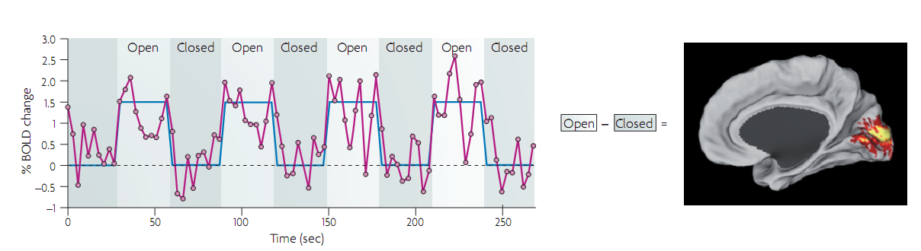
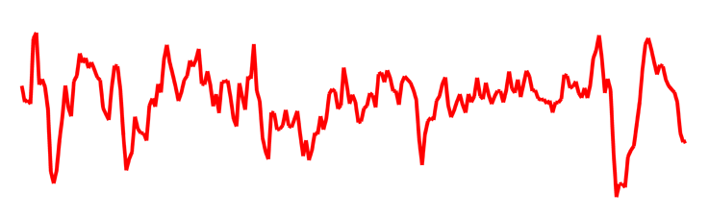
Resting-State fMRI: Principles
Task
Traditional fMRI analysis
Baseline
Noise?
Activities in the baseline state (usually resting-state)
Fox and Raichle, 2007. Nat Rev Neurosci
6

Slide 7
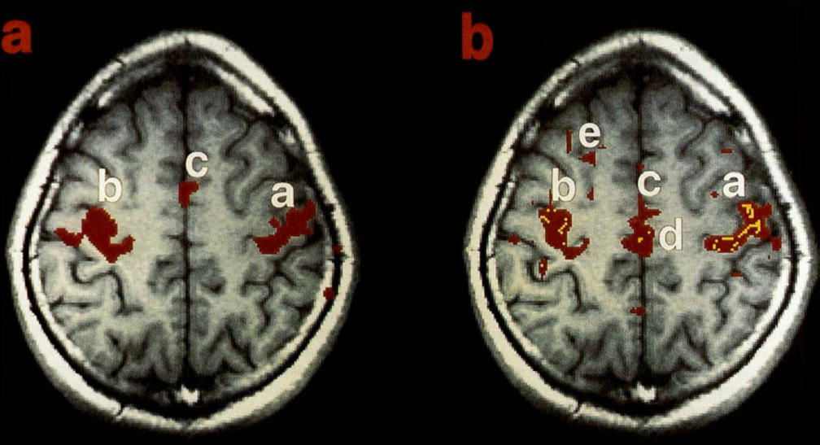
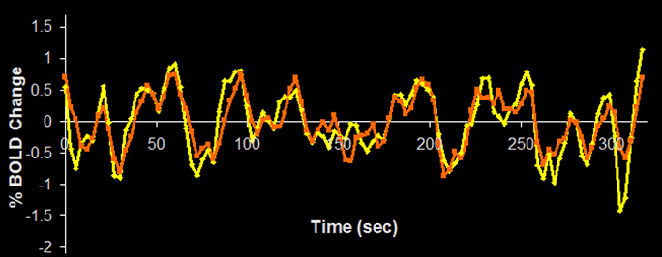
Resting-State fMRI: Principles
Temporal synchrony of spontaneous fluctuations
Task: left and right finger movement
Resting-state
Biswal et al., 1995. Magn Reson Med
7

Slide 8
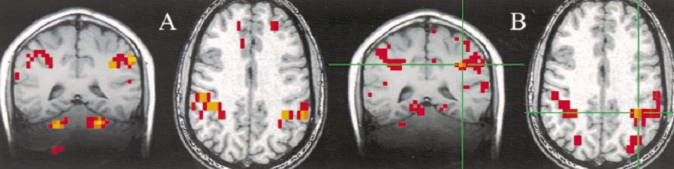
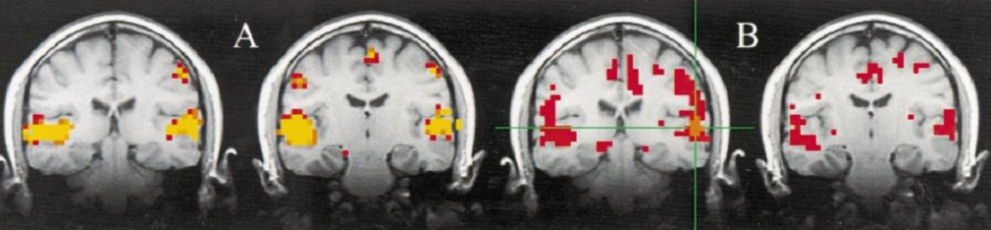
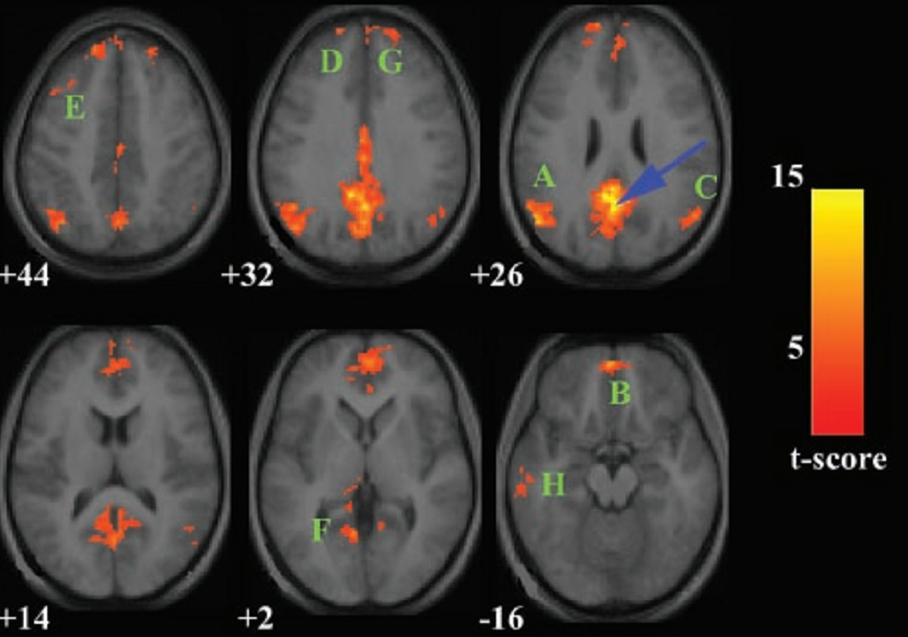
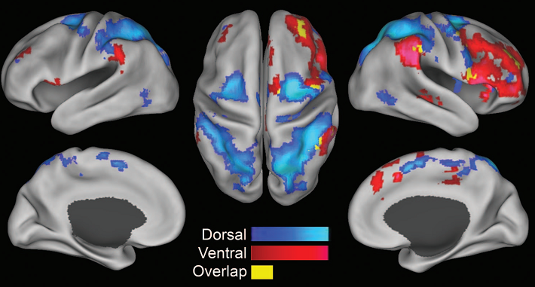
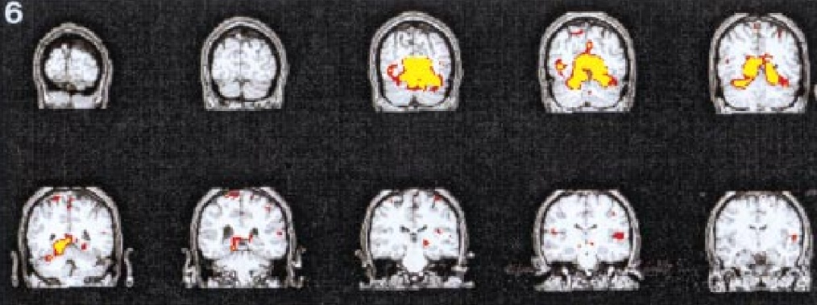
Resting-State fMRI: Principles
Functional networks identified by functional connectivity with resting-state fMRI (RS-fMRI)
Sensorimotor network (Cordes et al., 2000. AJNR)
Auditory network (Cordes et al., 2000. AJNR)
Visual network (Lowe et al., 1998. Neuroimage)
Attentional network (Fox et al., 2006. PNAS)
DMN (Greicius et al., 2003. PNAS)
8

Slide 9
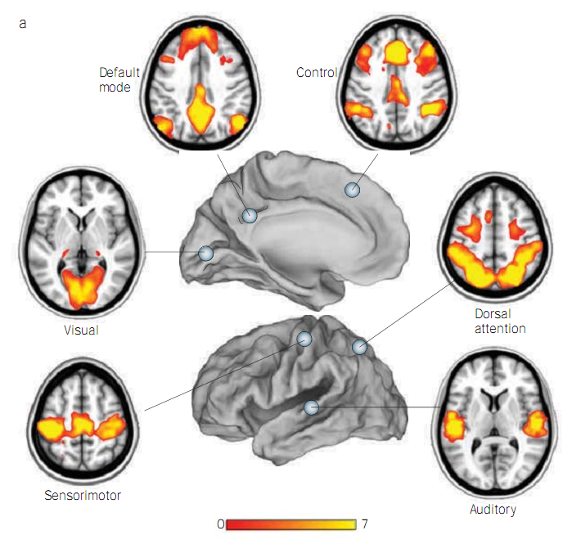
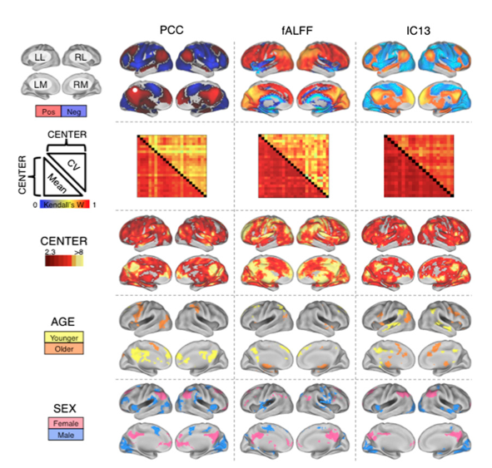
Resting-State fMRI: Principles
Zhang and Raichle, 2010. Nat Rev Neurol
Biswal et al., 2010. PNAS
9

Slide 10
Outline
Resting-State fMRI: Principles
Data Analysis: Computational Algorithms
Data Analysis: Methodological Issues
Data Analysis: Computational Platform
Applications to Cognitive Science
Applications to Brain Disorders
10

Slide 11
Computational Methodology
Integration approach
Regional approach
Graphical approach

Slide 12
Computational Methodology
Integration approach
Functional Connectivity
Correlation: (Biswal et al., 1995; ……)
ICA: (Kiviniemi et al., 2003; van de Ven et al., 2004; Greicius et al., 2004)
Effective Connectivity: (Friston et al., 2002)
Hierarchical Clustering: (Cordes et al., 2000; Salvador et al., 2005)
Self Organization Map: (Peltier et al., 2003)
....

Slide 13
Computational Methodology
Correlation: Temporal synchrony of spontaneous fluctuations
Task: left and right finger movement
Resting-state
Biswal et al., 1995. Magn Reson Med
13

Slide 14
Computational Methodology
The “Resting” Brain
Courtesy of Dr. Daniel Margulies

Slide 15
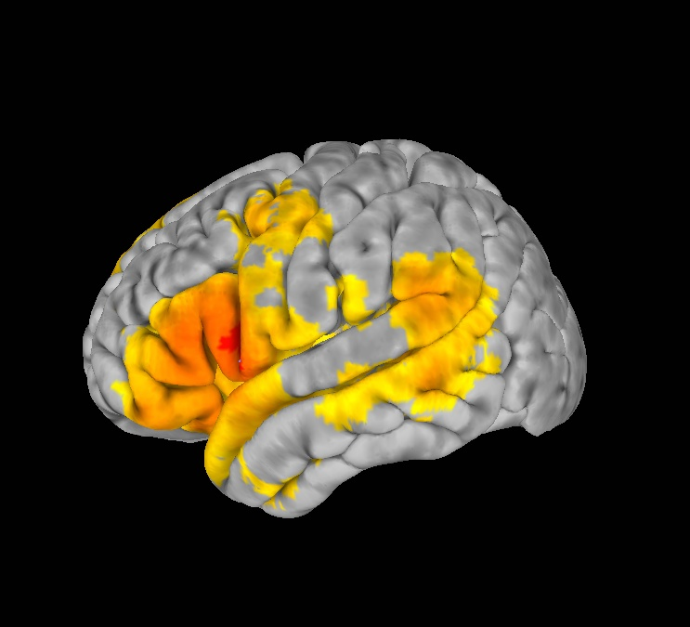
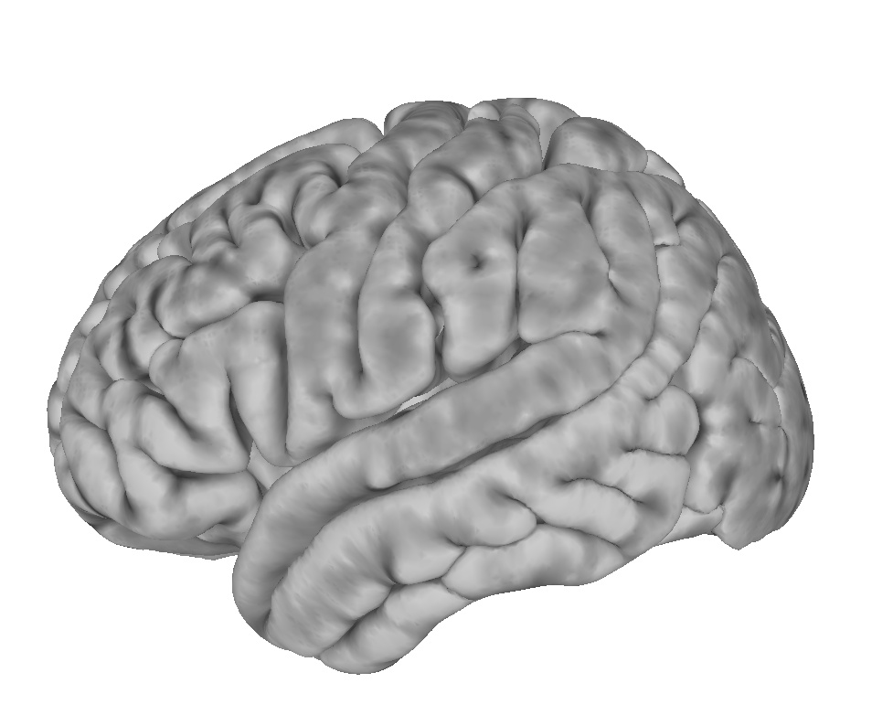
Computational Methodology
How do we detect organized patterns of intrinsic activity?
Resting State Functional Connectivity
Correlate
Notes:
How do we measure this organization?

Slide 16
Computational Methodology
Correlation
Zhang and Raichle, 2010. Nat Rev Neurol
16

Slide 17
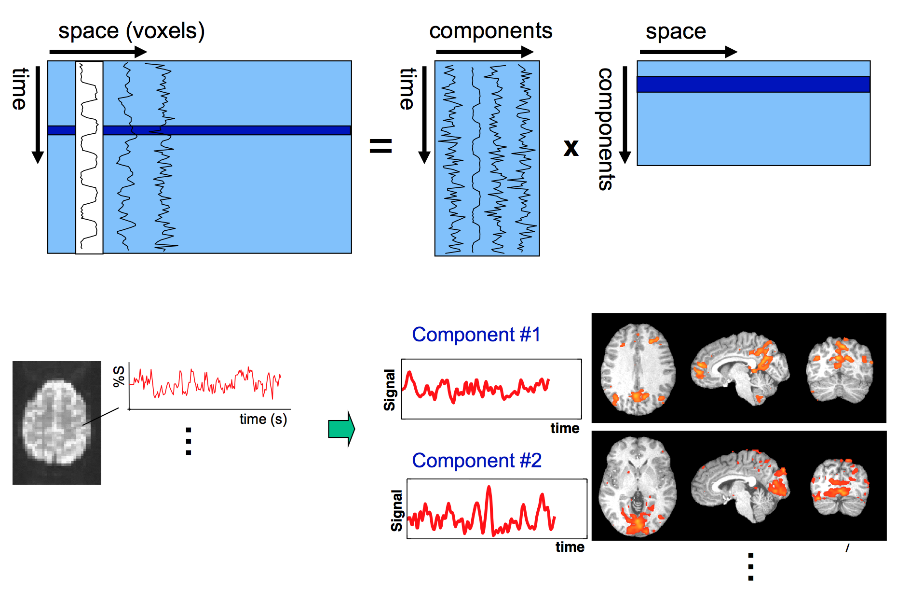
Computational Methodology
ICA
Birn
2015

Slide 18
Computational Methodology
Directionality
Association
(undirected network)
Directionality
Causality
(directed network)
18

Slide 19
Computational Methodology
Directionality
Statistical techniques
  Structural Equation Modeling (McIntosh and Gonzalez-Lima, 1994)
  Dynamic Causal Modeling (Friston et al., 2003)
  Granger causality analysis (GCA) (Granger, 1969; Goebel et al., 2003)
  ....
Lesion studies
Brain stimulation
Craddock, , Yan et al., 2013. Nat Methods

Slide 20
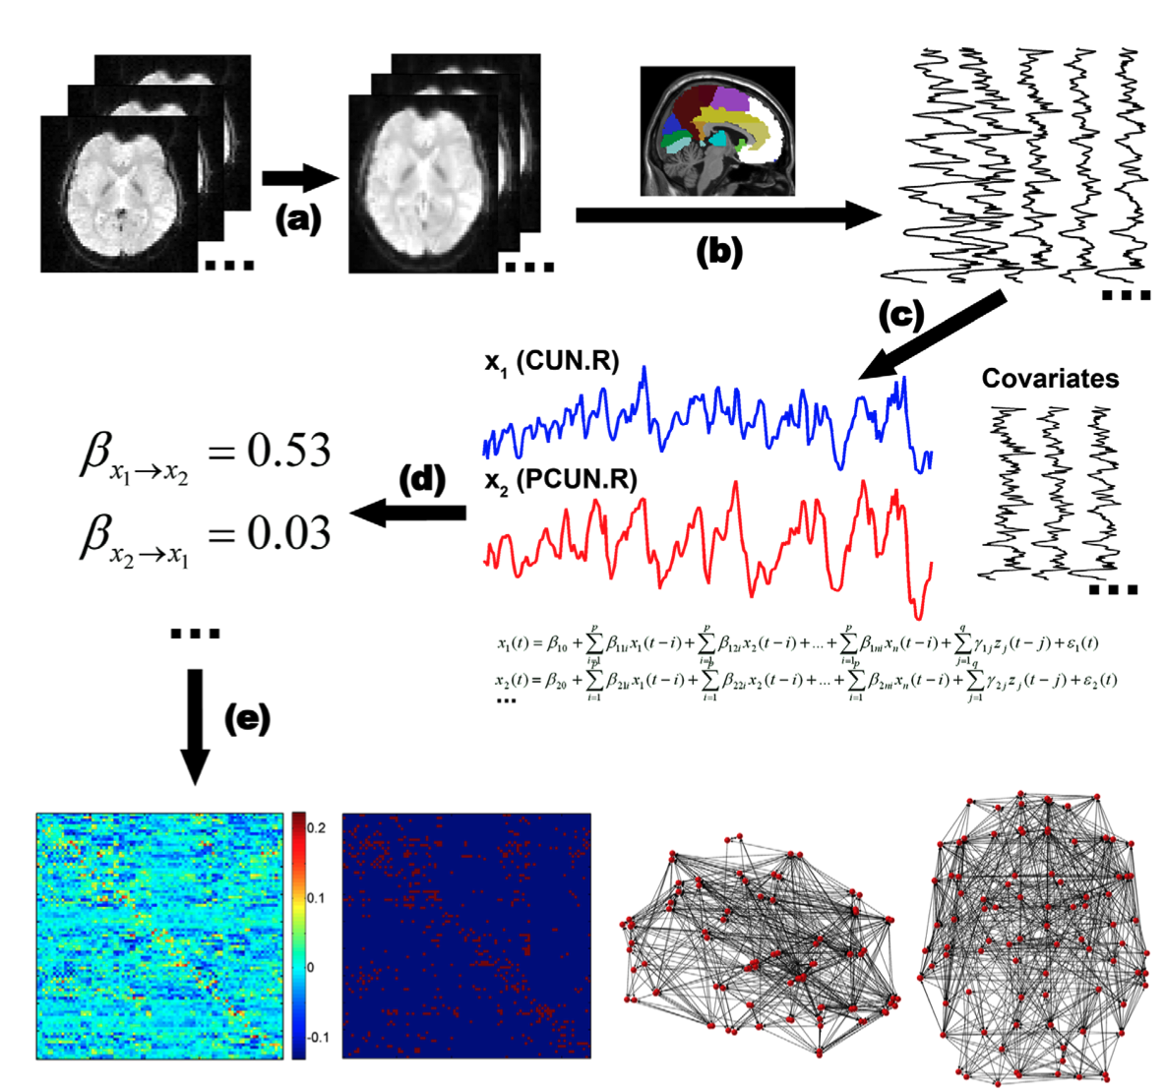
Computational Methodology
GCA in RS-fMRI
Yan et al., 2011.
PLoS ONE
20

Slide 21
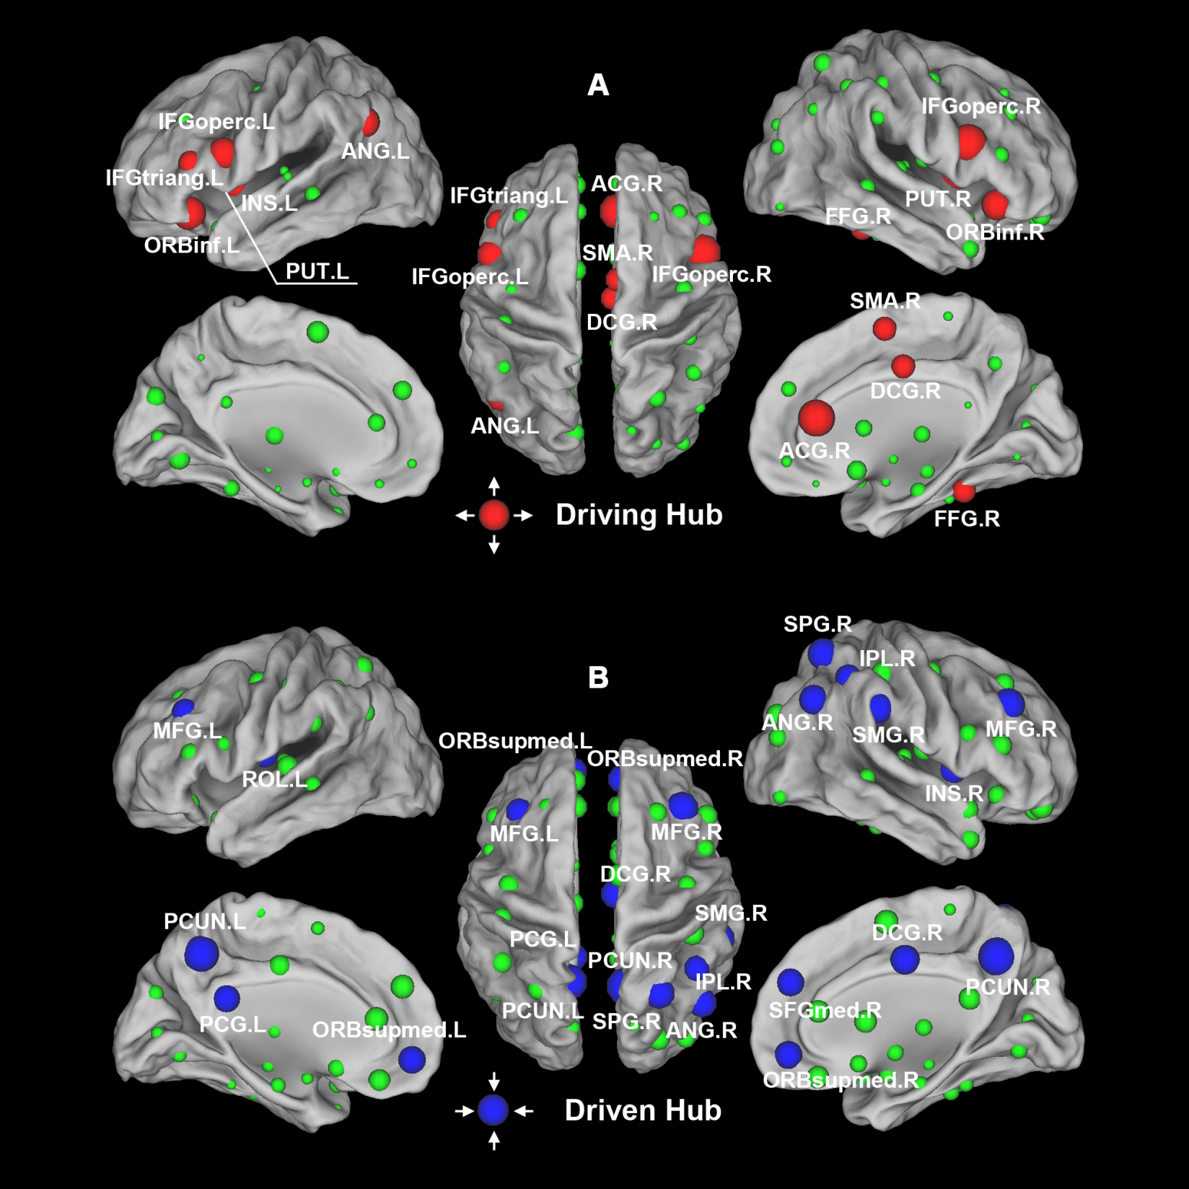
Computational Methodology
GCA in RS-fMRI
Yan et al., 2011.
PLoS ONE
21

Slide 22
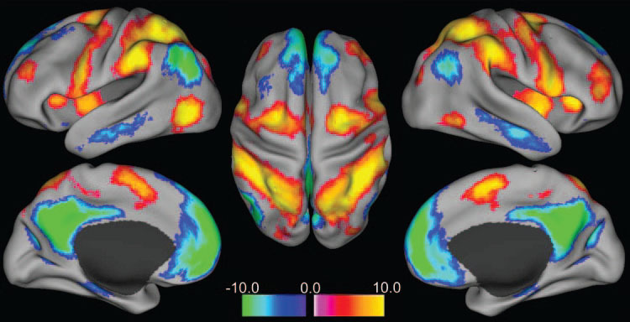
Results and discussion
Fox et al.,
2005.
PNAS
22

Slide 23
Results and discussion
Fox et al.,
2005.
PNAS
23

Slide 24
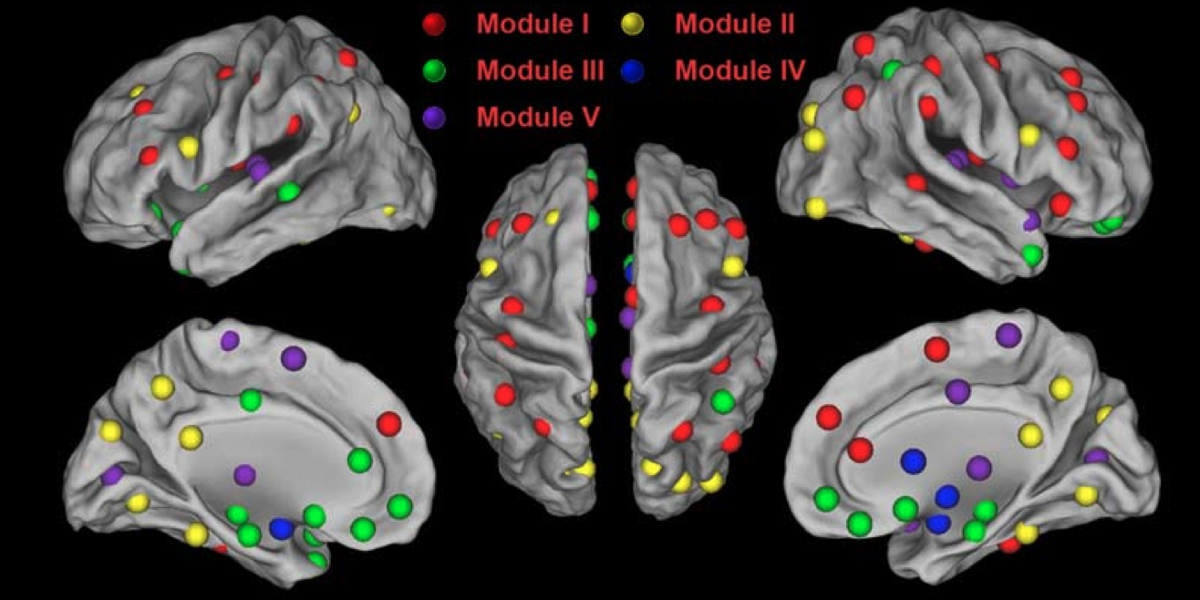
Computational Methodology
Yan et al., 2011.
PLoS ONE
24

Slide 25
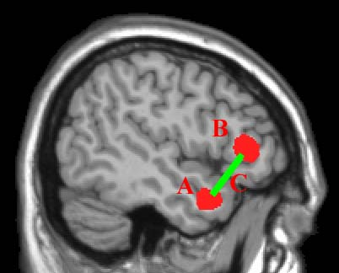
Computational Methodology
Regional approach
“Integrative” is really good, but:
Decreased
functional connectivity
Question: Is A, B, C, or……abnormal?

Slide 26
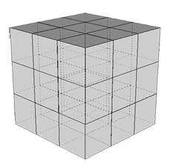
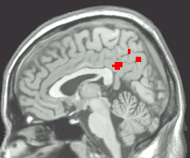
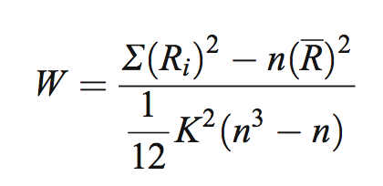
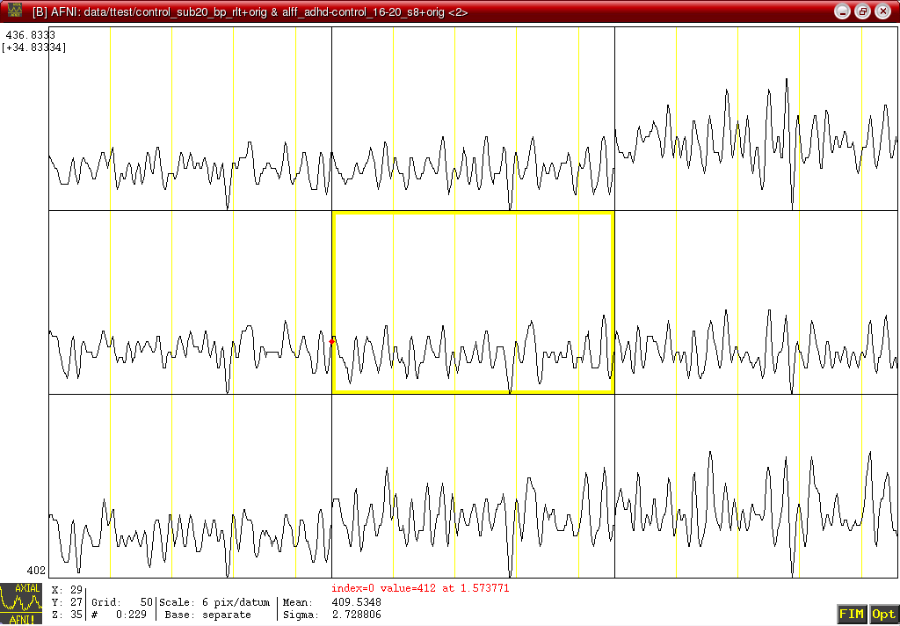
Regional Homogeneity (ReHo)
Computational Methodology
Similarity or coherence of the time courses within a functional cluster
(Zang et al., 2004)

Slide 27
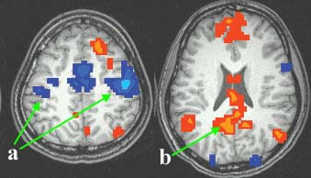
ReHo: motor task state vs. pure resting state
Computational Methodology
Rest > Motor
Motor > Rest
a) Higher ReHo in bilateral primary motor cortices during motor task
b) Higher ReHo in default mode network (PCC, MPFC, IPL) during rest (Raichle et al., 2001; Greicius et al., 2003)
(Zang et al., 2004)

Slide 28
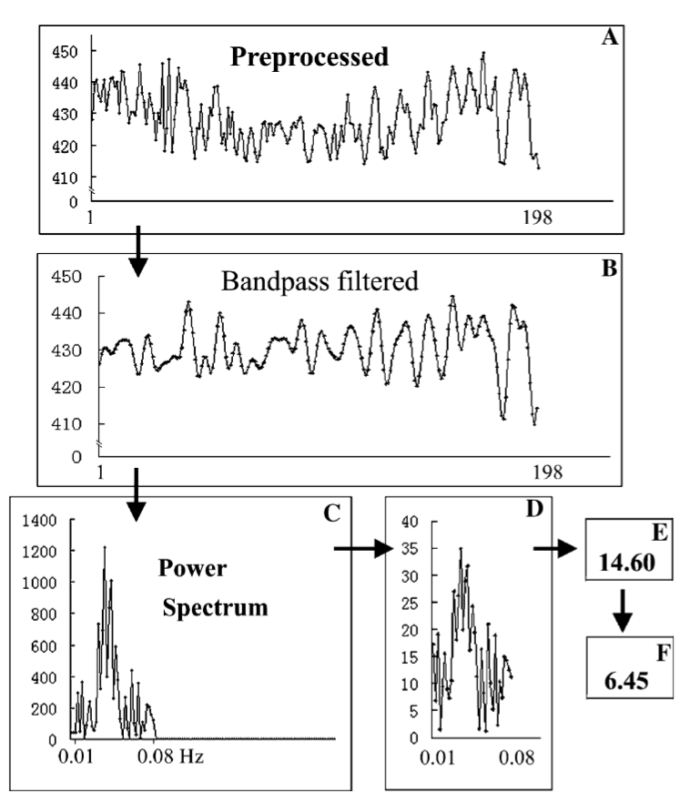
Amplitude of low frequency fluctuations
Zang et al., 2007
Notes:
How do we measure this organization?

Slide 29
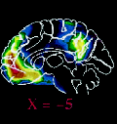
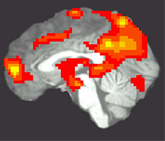
ALFF
Computational Methodology
PET
(Raichle et al., 2001)
ALFF
(Zang et al., 2007)
noise

Slide 30
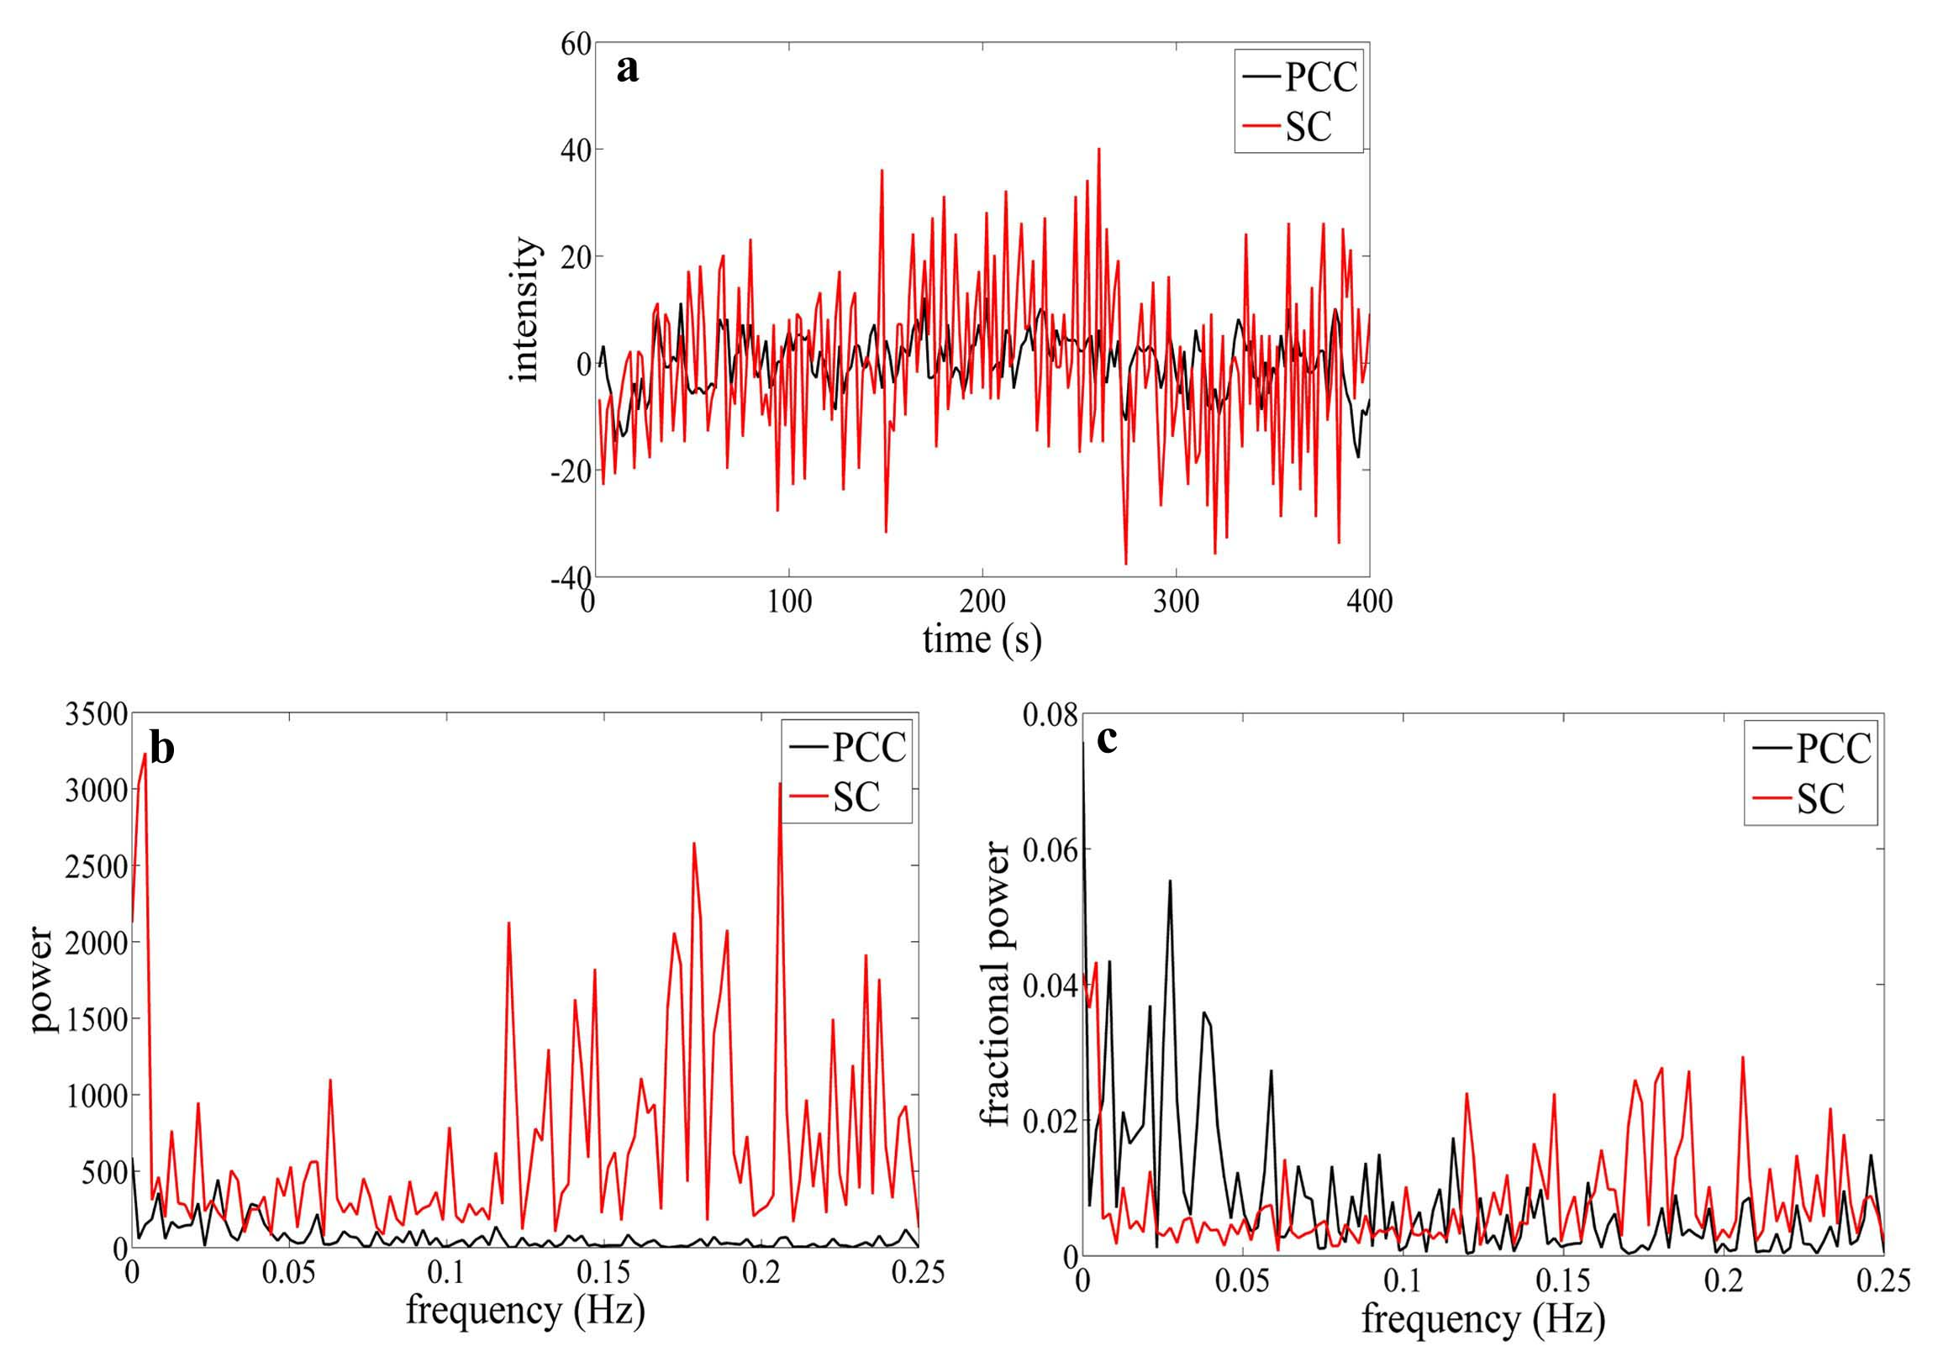


Improvement: fractional ALFF
Computational Methodology
Suprasellar cistern
PCC
Zou et al., 2008. J Neurosci Methods
Notes:
ADHD13例，正常对照儿童12例。静息态fMRI低频（0.01－0.08Hz）振幅（amplitude of low frequency fluctuation, ALFF）可能反映了自发脑活动的强度。SC:鞍上池

Slide 31
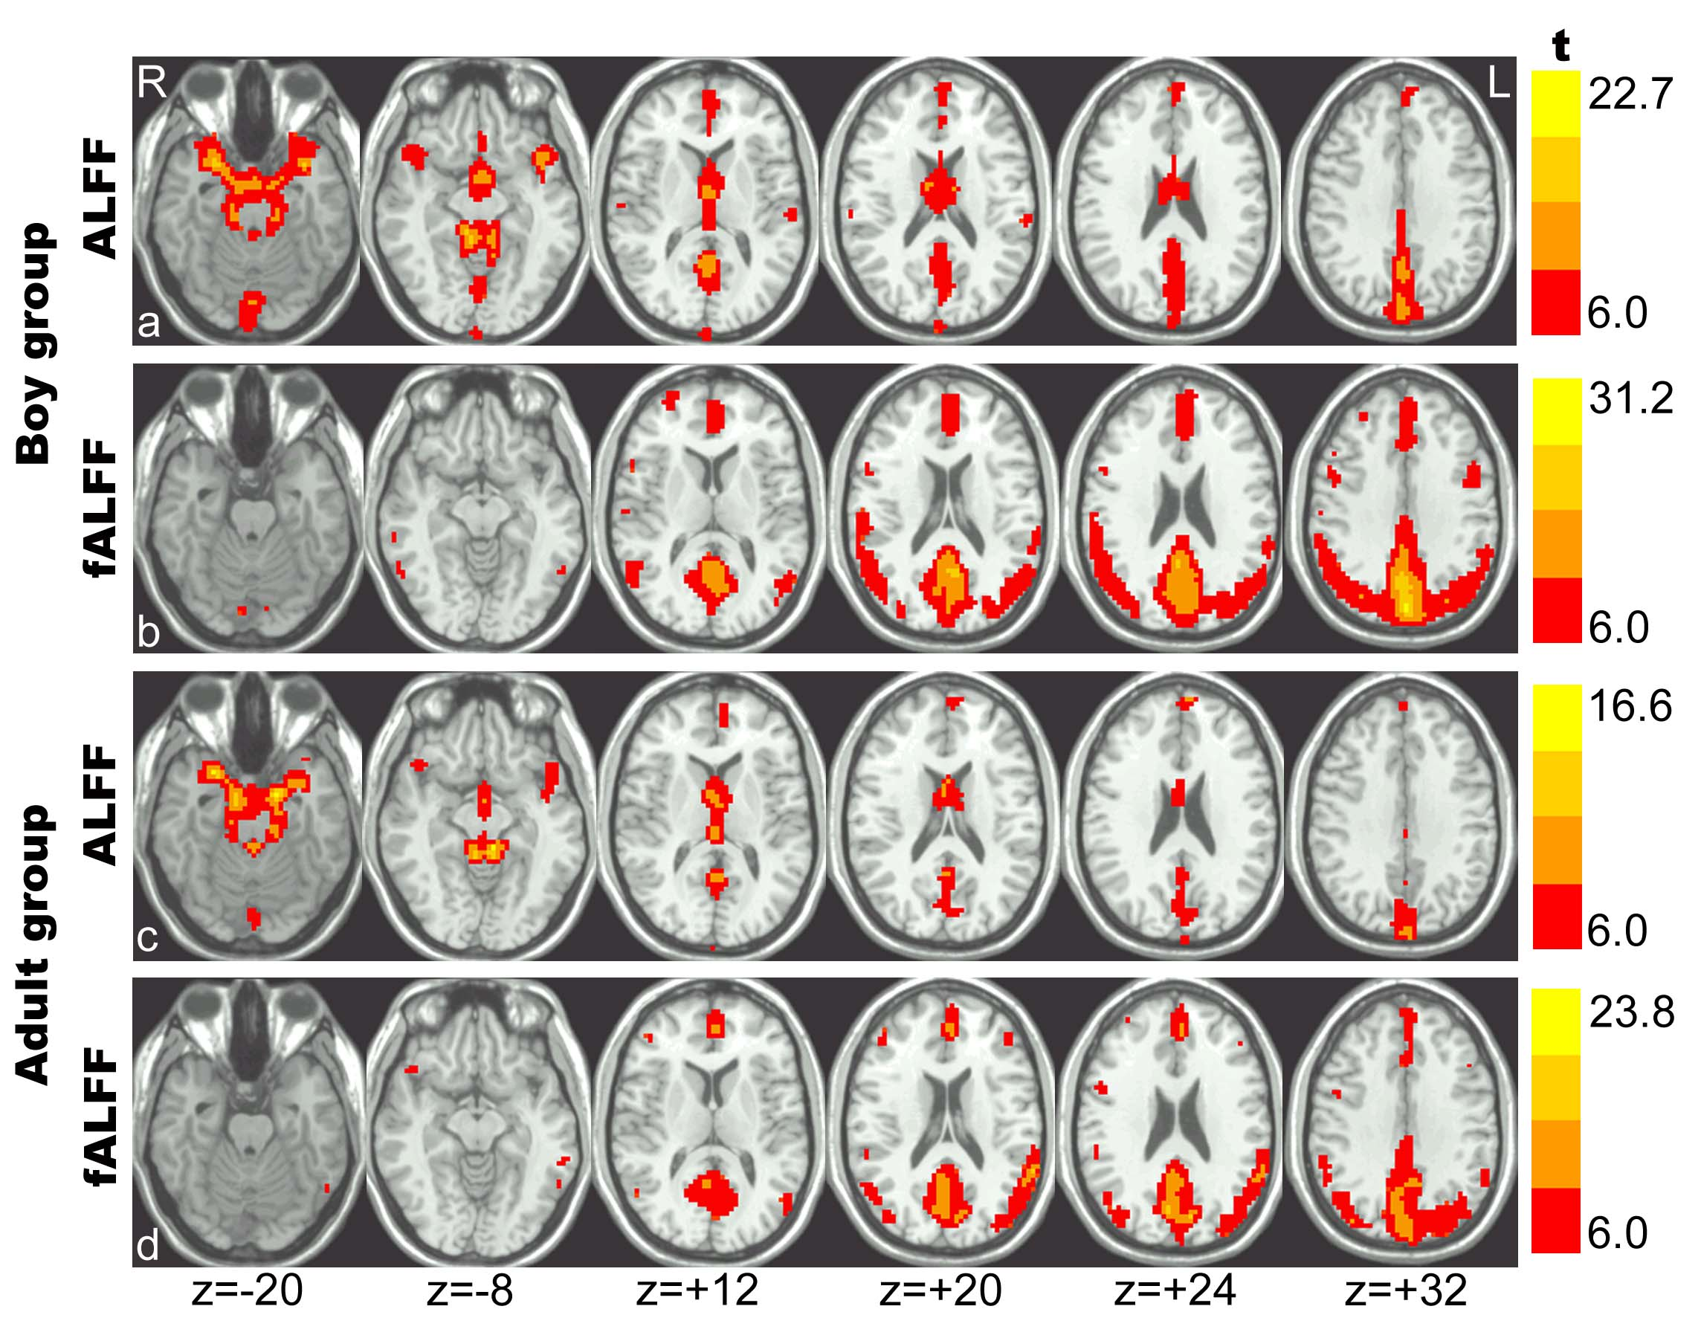
Improvement: fractional ALFF
Computational Methodology
Zou et al., 2008. J Neurosci Methods
Notes:
ADHD13例，正常对照儿童12例。静息态fMRI低频（0.01－0.08Hz）振幅（amplitude of low frequency fluctuation, ALFF）可能反映了自发脑活动的强度。SC:鞍上池

Slide 32
Computational Methodology
Graphical approach
Graph theoretical analysis: (Salvador et al., 2005, Bullmore and Sporns, 2009)
  Degree connectivity, functional connectivity density, degree centrality: (Buckner et al., 2009; Tomasi et al., 2010; Cole et al., 2010; Zuo et al., 2012)
…

Slide 33
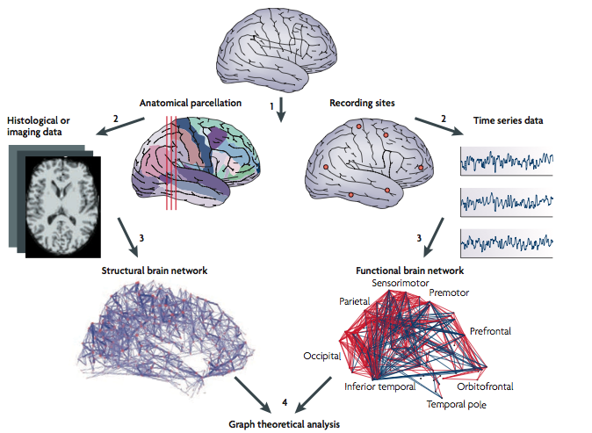
Computational Methodology
Graph theoretical analysis
Bullmore and Sporns, 2009

Slide 34
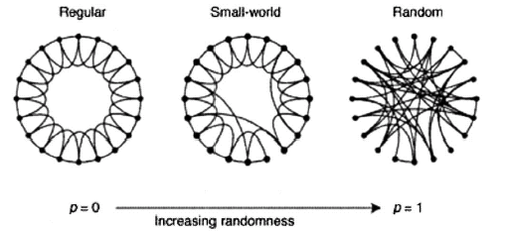
Computational Methodology
Graph theoretical analysis
Node: brain region
Link: connection
Watts and Strogatz, 1998. Nature
Regular:
high Cp
high Lp
Small-world:
high Cp
low Lp
Random:
low Cp
low Lp
Small-world networks contain many local links and a few long-distance links (so-called “shortcuts”).
Cp: average clustering of a network
Lp: average shortest path length of a network
34

Slide 35
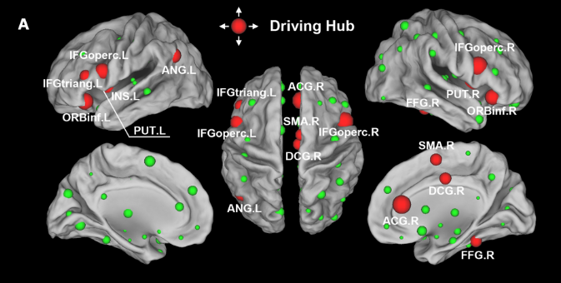
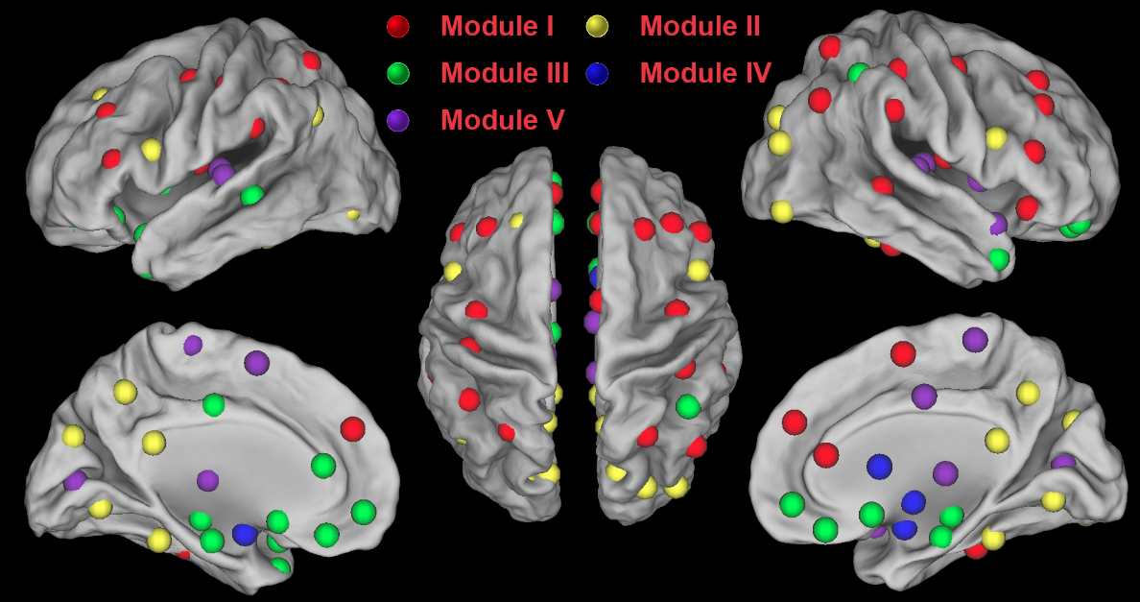
Computational Methodology
Graph theoretical analysis
Hub
Module
Yan et al., 2011. PLoS ONE

Slide 36
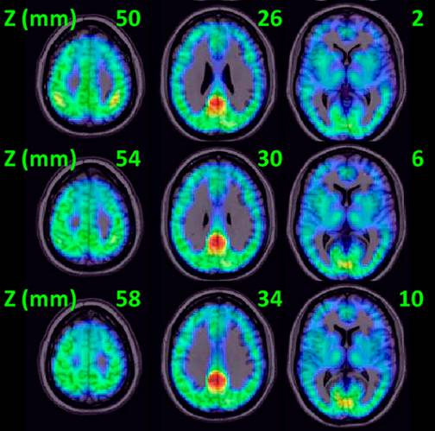
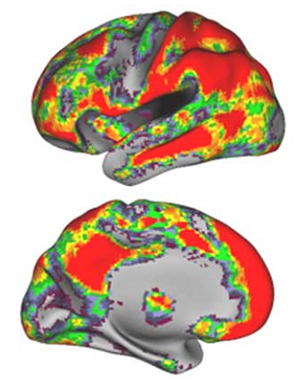
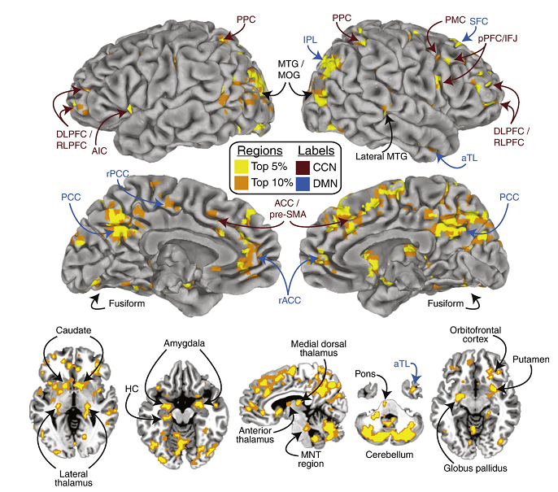
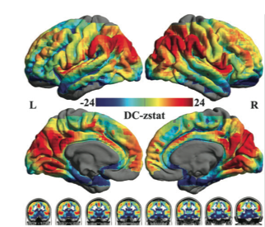
Computational Methodology
Degree centrality
Buckner et al., 2009. J Neurosci
Tomasi et al., 2010. PNAS
Cole et al., 2010. Neuroimage
Zuo et al., 2011. Cereb Cortex

Slide 37
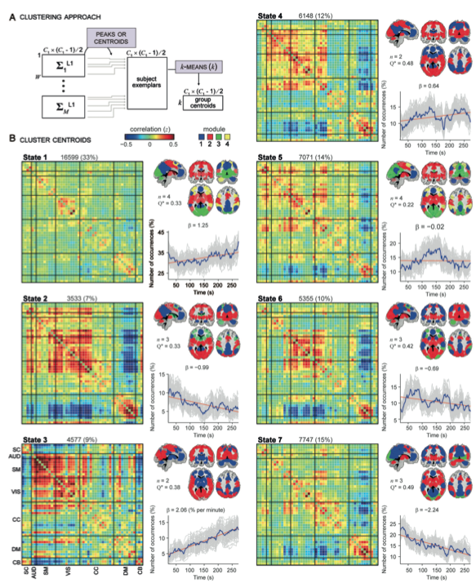
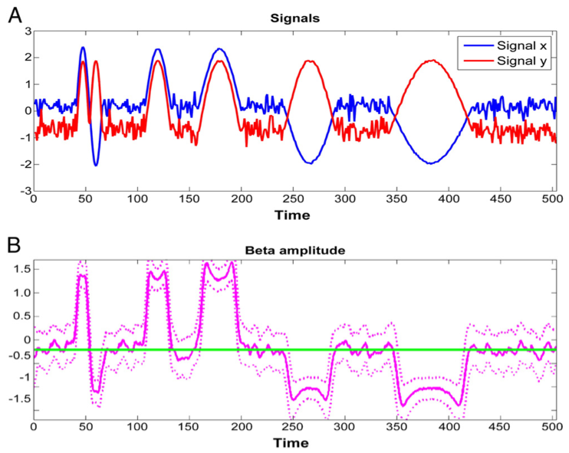
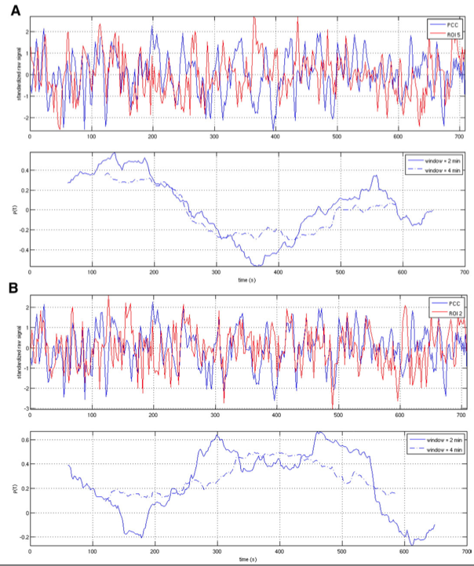
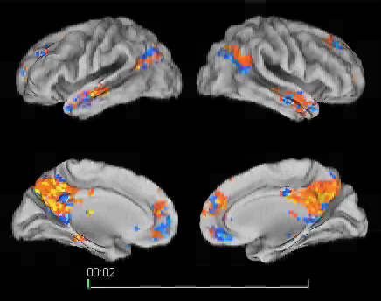
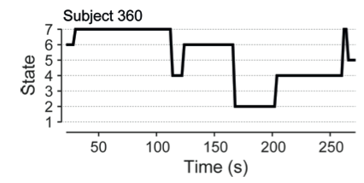
Computational Methodology
Dynamic perspective
Chang and Glover, 2010.
Neuroimage
Kang, , Yan et al., 2011.
Neuroimage
Allen et al., 2013.
Cereb Cortex

Slide 38
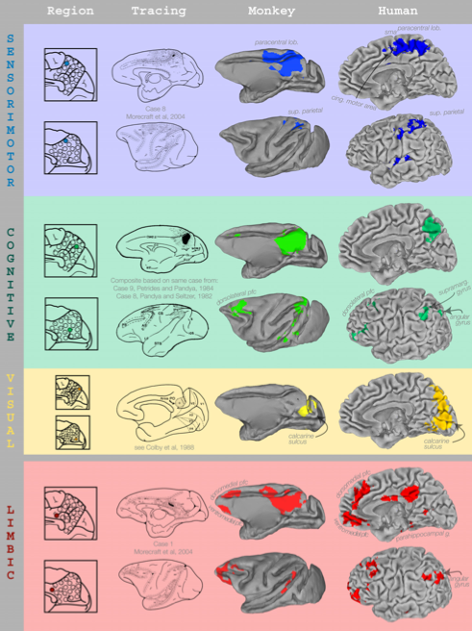
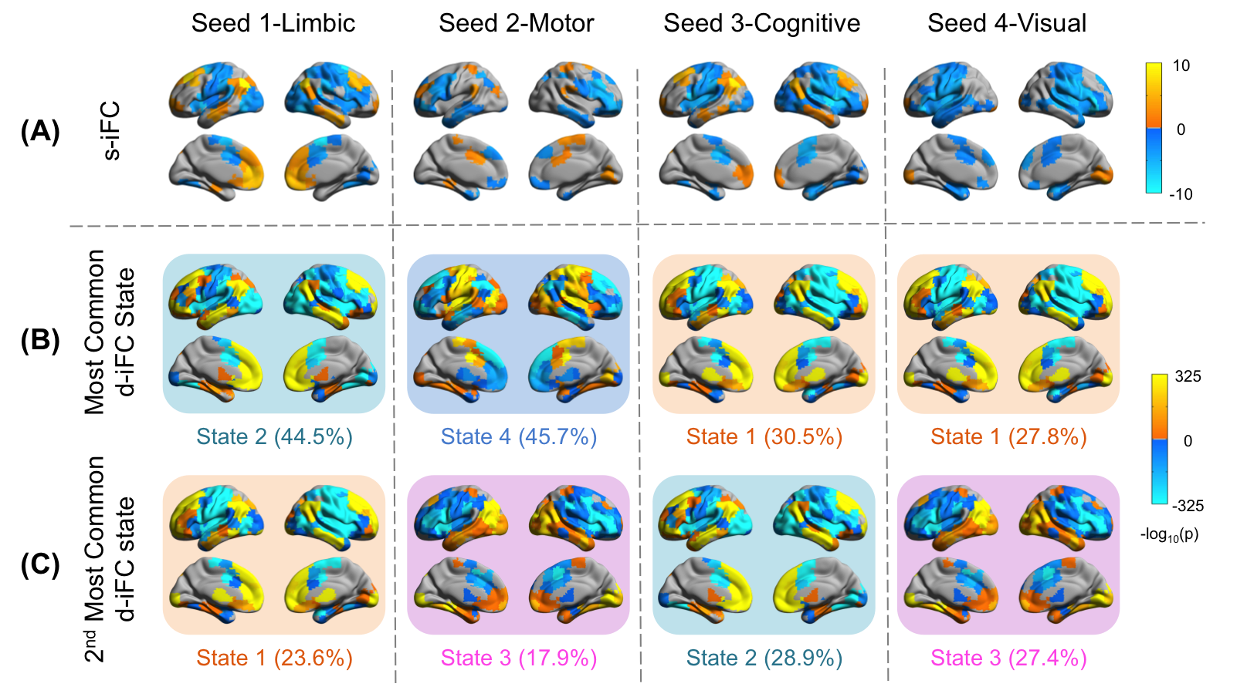
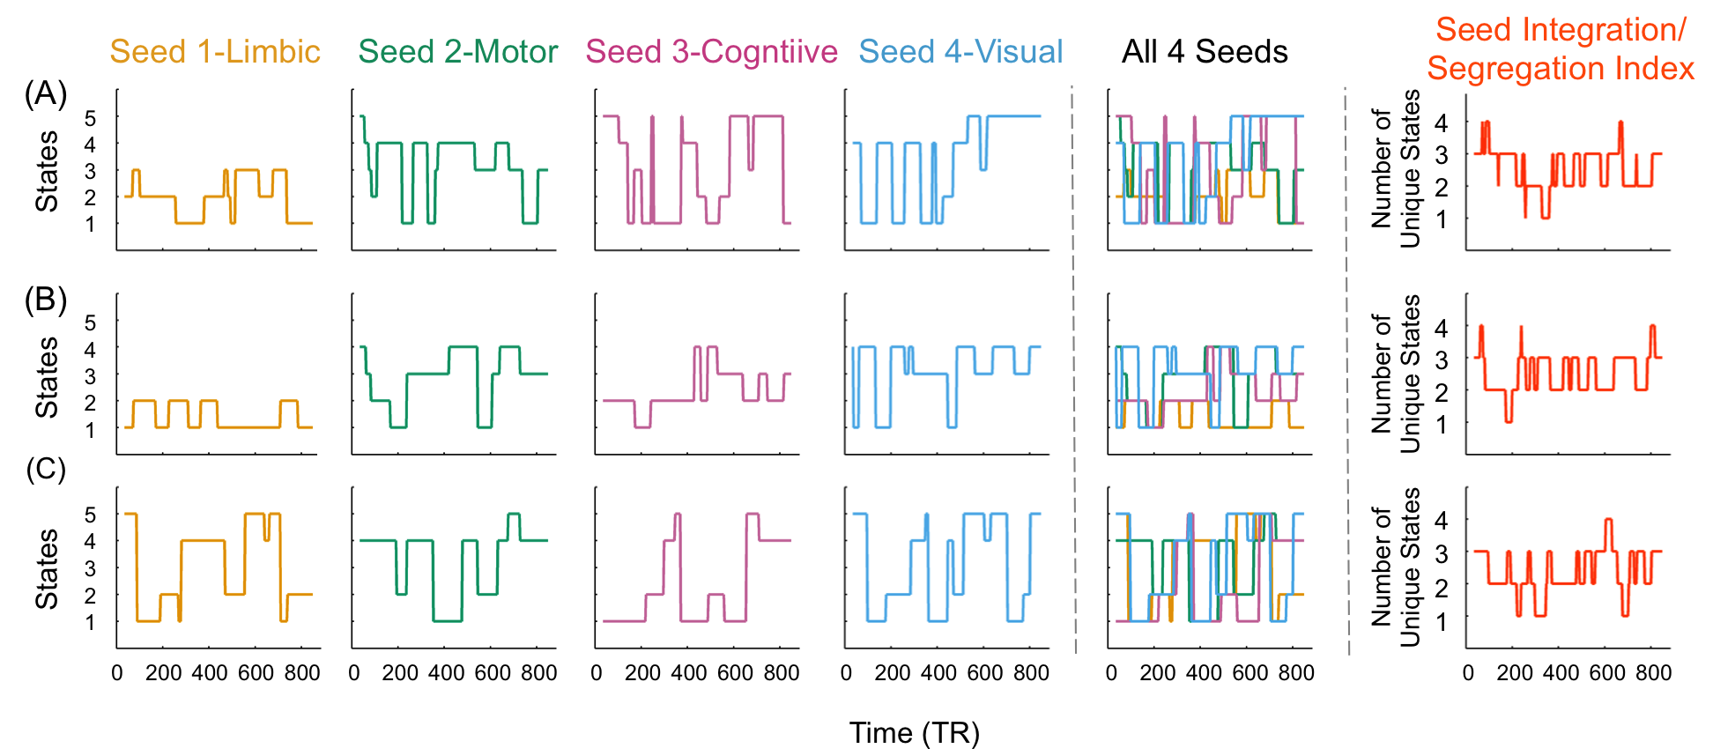
Computational Methodology
Dynamic perspective
Margulies et al., 2009. PNAS
Yang, , Yan, Milham, 2014. Neuroimage

Slide 39
Outline
Resting-State fMRI: Principles
Data Analysis: Computational Algorithms
Data Analysis: Methodological Issues
Data Analysis: Computational Platform
Applications to Cognitive Science
Applications to Brain Disorders
39

Slide 40
Methodological Issues
Experiment settings
Head motion
Global signal regression
Standardization
And many many more…
Yan et al., 2009. PLoS ONE;
Wang, , Yan et al., 2012. PLoS ONE
Yan et al., 2013a. Neuroimage
Yan et al., 2013. Front Hum Neurosci
Yan et al., 2013a, b. Neuroimage
Yan et al., 2013c. Front Hum Neurosci
Yan et al., 2013b. Neuroimage

Slide 41
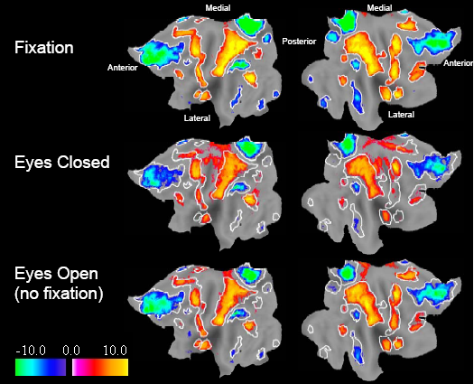
Different resting conditions?
Methodological Issues
The functional connectivity patterns of the default mode network was minimally disturbed during different resting conditions with limited cognitive demand (Greicius et al., 2003; Fransson, 2005; Fox et al., 2005)
Fox et al., 2005. PNAS

Slide 42

Different resting conditions?
Methodological Issues
Functional connectivity maps
Significantly different between different resting conditions with limited cognitive demand
Yan et al., 2009. PLoS ONE

Slide 43

Different resting conditions?
Methodological Issues
Regional activity (ALFF)
Yan et al., 2009. PLoS ONE

Slide 44

Different resting conditions?
Methodological Issues
Functional connectivity strength
Functional connectivity strength was significantly diminished for eyes closed rest (ECR) when compared with the fixation (fix)
Van Dijk et al., 2010. J Neurophysiol

Slide 45

Different resting conditions?
Methodological Issues
Patriat et al., 2013. Neuroimage

Slide 46

Order of resting-state conditions?
Methodological Issues
First EC
-
Second EC
Yan et al., 2009. PLoS ONE

Slide 47
Order of resting-state conditions?
Methodological Issues
Scanning sessions (3T Siemens):
S1 Resting-state (Rest1) 8 min
S2 Pictures (indoor or outdoor) (encoding) 5 min
S3 3D structure 8 min
S4 Resting-state (Rest2) 8 min
S5 Retrieval: old or new (2 runs) 10 min
Rest2/Rest1: spontaneous brain activity modulation by task
Wang, , Yan et al., 2012. PLoS ONE

Slide 48

Order of resting-state conditions?
Methodological Issues
Wang, , Yan et al., 2012. PLoS ONE

Slide 49
Methodological Issues
Experiment settings
Make resting-state condition consistent: e.g., fixation (depends on the cooperation of participants).
Make resting-state session before task sessions, unless intended.

Slide 50



Head motion matters
Methodological Issues
Van Dijk et al, 2012. Neuroimage
Power et al, 2012. Neuroimage
Satterthwaite et al., 2012. Neuroimage

Slide 51

Head motion matters
Methodological Issues
Yan et al., 2013a. Neuroimage

Slide 52

Head motion matters
Methodological Issues
Yan et al., 2013a. Neuroimage

Slide 53

Head motion matters
Methodological Issues
Yan et al., 2013a. Neuroimage

Slide 54


Head motion matters
Methodological Issues
Yan et al., 2013a. Neuroimage

Slide 55

Methodological Issues
Head Motion
Yan et al., 2013a. Neuroimage

Slide 56





Global Signal Regression
Methodological Issues
Murphy et al., 2009. Neuroimage
Fox et al., 2009. J Neurophysiol

Slide 57

Global Signal Regression
Methodological Issues
Yan et al., 2013b. Neuroimage

Slide 58

Global Signal Regression
Methodological Issues
Saad et al., 2013. Brain Connect

Slide 59

Global Signal Regression
Methodological Issues
Yan et al., 2013c. Front Hum Neurosci

Slide 60

Global Signal Regression
Methodological Issues
Yan et al., 2013c. Front Hum Neurosci

Slide 61



Global Signal Regression
Methodological Issues
Yan et al., 2013b. Neuroimage
Motion effect Age effect

Slide 62
Methodological Issues
Global Signal Regression
Still hot controversial yet!!
No GSR + group-level mean regression (see next section also).
Check GSR as complimentary analysis if is interested in.
More GSR mechanism studies needed!

Slide 63



Standardization
Methodological Issues
Yan et al., 2013b. Neuroimage

Slide 64
Standardization
Methodological Issues
Yan et al., 2013b. Neuroimage

Slide 65

65
Notes:
Two Subjects
C: Scrubbed - unscrubbed

Slide 66

Systematic Variation in Common Standardization Parameters: Global Mean
Yan et al., 2013b
Neuroimage
1000 Functional Connectomes Project dataset: 828 subjects used in statistical analyses
66
Notes:
Two Subjects
C: Scrubbed - unscrubbed

Slide 67

Systematic Variation in Common Standardization Parameters: Global SD
Yan et al., 2013b
Neuroimage
1000 Functional Connectomes Project dataset: 828 subjects used in statistical analyses
67
Notes:
Two Subjects
C: Scrubbed - unscrubbed

Slide 68

The Impact of Standardization Procedures on Confound Variables: Site Effects
1000 Functional Connectomes Project dataset: 828 subjects used in statistical analyses
68
Notes:
Two Subjects
C: Scrubbed - unscrubbed

Slide 69

The Impact of Standardization Procedures on Confound Variables: Motion Effects
1000 Functional Connectomes Project dataset: 828 subjects used in statistical analyses
69
Notes:
Two Subjects
C: Scrubbed - unscrubbed

Slide 70

The Impact of Standardization Procedures on Variables of Interest: Age Effects
70
Notes:
Two Subjects
C: Scrubbed - unscrubbed

Slide 71

The Impact of Standardization Procedures on Variables of Interest: Sex Effects
71
Notes:
Two Subjects
C: Scrubbed - unscrubbed

Slide 72

The Impact of Standardization Procedures on Variables of Interest: Age Effects
72
Notes:
Two Subjects
C: Scrubbed - unscrubbed

Slide 73
Methodological Issues
Standardization
Mean regression-based approach.
Mean regression + SD division (for controlling mulplicative effects).

Slide 74
Outline
Resting-State fMRI: Principles
Data Analysis: Computational Algorithms
Data Analysis: Methodological Issues
Data Analysis: Computational Platform
Applications to Cognitive Science
Applications to Brain Disorders
74

Slide 75



Data Processing Assistant for Resting-State fMRI (DPARSF)
Yan and Zang, 2010. Front Syst Neurosci.
http://rfmri.org/DPARSF
Cited for >600 times

Slide 76



DPABI: a toolbox for Data Processing & Analysis of Brain Imaging
License: GNU GPL
Chao-Gan Yan Programmer Initiator
Xin-Di Wang Programmer
http://rfmri.org/dpabi
http://dpabi.org
Yan et al., submitted.

Slide 77
Data Organization
ProcessingDemoData.zip
  FunRaw
    Sub_001
    Sub_002
    Sub_003
  T1Raw
    Sub_001
    Sub_002
    Sub_003
Functional DICOM data
Structural DICOM data

Slide 78


Resting State fMRI Data Processing
Template Parameters
78

Slide 79

79

Slide 80


Slide 81

Quality Control
81

Slide 82
Quality Control
82

Slide 83

Quality Control
83

Slide 85


Statistical Analysis
85

Slide 87


Slide 88


Slide 89

89

Slide 90

Further Help
90

Slide 91


91

Slide 92
Outline
Resting-State fMRI: Principles
Data Analysis: Computational Algorithms
Data Analysis: Methodological Issues
Data Analysis: Computational Platform
Applications to Cognitive Science
Applications to Brain Disorders
92

Slide 93

Off-line spontaneous brain activity
and memory consolidation
Reverse replay of behavioral sequences in hippocampal place cells during the awake state.
Foster and Wilson, 2006. Nature; Colgin and Moser, 2006. Nature

Slide 94

Resting-state fMRI and memory consolidation
Motor learning group
Control group
Motor learning but not motor performance modulated subsequent frontal-parietal resting-state network
Albert et al., 2009. Curr Biol

Slide 95


Enhanced brain correlations during rest are related to memory for recent experiences
Tambini et al., 2010. Neuron
Retrieval results
Notes:
左baseline rest: 表示时间进程；右baseline rest表示任务为rest。为什么face-object成绩比face-scene高？Hits-misses，相当于d-prime，但后者是z分相减。尽管counter-balanced,但顺序效应可能过强？

Slide 96


Enhanced brain correlations during rest are related to memory for recent experiences
Tambini et al., 2010. Neuron
Notes:
B激活曲线。C任务FC;D静息FC。成绩较好的Object-face之后，FC增强。问题：PPA实际上既对object，也对scene加工？

Slide 97
Episodic memory and Alzheimer disease:
Subtle change of episodic memory is the earliest cognitive deficit in AD (Schwindt & Black, 1999, NeuroImage)
Consistently decreased activation in AD patients during both encoding and retrieval stages of episodic memory (Schwindt & Black, 2009, NeuroImage)
Encoding
Mechanism of episodic memory consolidation after encoding?
Consolidation
Retrieval

Slide 98
Resting-state fMRI, memory consolidation, APOE ε4
Question-1: Resting-state fMRI, hippocampus activity, and APOE ε4 healthy carriers?
Question-2: Spontaneous activity modulation by episodic memory task in the brain regions for encoding?

Slide 99
Resting-state fMRI, memory consolidation, APOE ε4
Participants:
917 students
2/2 2/3 2/4 3/3 3/4 4/4
1 52 13 799 51 1
Two groups of healthy APOE carriers: ε4/3 vs. ε2/3, n = 20 vs 19, (half males), 18 – 23 yrs from BNU, match for IQ and education
Wang, , Yan et al., 2012. PLoS ONE

Slide 100
Design
Scanning sessions (3T Siemens):
S1 Resting-state (Rest1) 8 min
S2 Pictures (indoor or outdoor) (encoding) 5 min
S3 3D structure 8 min
S4 Resting-state (Rest2) 8 min
S5 Retrieval: old or new (2 runs) 10 min
Rest2/Rest1: spontaneous brain activity modulation by task
Wang, , Yan et al., 2012. PLoS ONE

Slide 101
Behavior result: retrieval performance
d’ mean SD t p
2/3 2.46 0.68
3/4 2.54 0.63
-0.387 0.7
No significant difference between the two groups
Wang, , Yan et al., 2012. PLoS ONE

Slide 102
Hippocampus
(P < 0.05, SVC)
Wang, , Yan et al., 2012. PLoS ONE

Slide 103
Outline
Resting-State fMRI: Principles
Data Analysis: Computational Algorithms
Data Analysis: Methodological Issues
Data Analysis: Computational Platform
Applications to Cognitive Science
Applications to Brain Disorders
103

Slide 104
Applications to Brain Disorders
Alzheimer's Dementia (AD)
Preoperative (Tumor)
…

Slide 105
Applications to Brain Disorders
ALFF in AD

Slide 106



Applications to Brain Disorders
ALFF in AD
Wang*, Yan* et al., 2011, Hum Brain Mapp
Notes:
a sensitivity of 81% and a specificity of 73%.

Slide 107

Applications to Brain Disorders
Degree centrality in AD
Dai, Yan et al., 2014. Cerebral Cortex.

Slide 108

Applications to Brain Disorders
Degree centrality in AD
Dai, Yan et al., in prep.

Slide 109

Applications to Brain Disorders
Classification in AD
Multi-modal imaging and multi-level characterization with multi-classifier (M3)
Features
  ALFF
  ReHo
  Regional correlation strength
  Gray matter density
Accuracy: 89.47%
Dai*, Yan* et al., 2012, NeuroImage

Slide 110
Applications to Brain Disorders
Functional connectivity in Preoperative (Tumor)

Slide 111


Applications to Brain Disorders
Functional connecitivty in Preoperative (Tumor)
Case 1
Case 2
Zhang et al., 2009. Neurosurgery

Slide 112






Direct Cortical Stimulation
Applications to Brain Disorders
Functional connectivity in Preoperative (Tumor)
R
L
L
R
Motor task fMRI (top 2%)
Illustrative Case 16
Qiu*, Yan* et al., 2014. Acta Neurochir
R-fMRI iFC of hand area (top 2%)

Slide 113


Applications to Brain Disorders
H: hand M: mouth
Qiu*, Yan* et al., 2014. Acta Neurochir

Slide 114








Applications to Brain Disorders
L: leg; H: hand; M: mouth;
1, 2, 3: speech arrest; 5, 6: picture naming
Post-op
muscle strength: V
Illustrative Case 13: CANNOT perform motor fMRI task
Qiu*, Yan* et al., 2014. Acta Neurochir

Slide 115
Applications to Brain Disorders
No | Age | Sex | Lesion locate | real positive | real negative | false positive | false negative
1 | 41 | M | Left frontal | 2 | 24 | 4 | 0
2 | 23 | M | Left frontal | 2 | 37 | 2 | 0
3 | 38 | M | Left frontal | 2 | 33 | 4 | 0
4 | 27 | M | Left parietal | 1 | 39 | 8 | 0
5 | 51 | F | Left frontal | 2 | 8 | 4 | 0
6 | 36 | F | Left frontal | 1 | 25 | 8 | 0
7 | 67 | F | Left frontal | 2 | 6 | 4 | 0
8* | 49 | M | right parietal
9 | 39 | M | Left frontal | 1 | 33 | 6 | 0
10 | 40 | M | Left frontal | 2 | 34 | 2 | 1
11 | 49 | M | Left frontal | 1 | 40 | 3 | 2
12 | 45 | F | right frontal | 0 | 35 | 7 | 1
13* | 32 | M | Left frontal
14 | 39 | F | right frontal | 2 | 28 | 2 | 0
15 | 50 | M | Left frontal | 2 | 18 | 9 | 0
16 | 23 | M | Left frontal | 1 | 36 | 9 | 0
17 | 34 | F | Left frontal | 1 | 23 | 2 | 1
total |  |  |  | 22 | 419 | 74 | 5
Sensitivity / Specificity |  |  |  | 78.57% / 84.76%
Motor task
No | Age | Sex | Lesion locate | real positive | real negative | fault positive | fault negative
1 | 41 | M | Left frontal | 4 | 26 | 0 | 0
2 | 23 | M | Left frontal | 2 | 36 | 3 | 0
3 | 38 | M | Left frontal | 3 | 33 | 3 | 0
4 | 27 | M | Left parietal | 1 | 41 | 6 | 0
5 | 51 | F | Left frontal | 2 | 8 | 4 | 0
6 | 36 | F | Left frontal | 1 | 25 | 8 | 0
7 | 67 | F | Left frontal | 0 | 9 | 1 | 2
8 | 49 | M | right parietal | 1 | 32 | 2 | 0
9 | 39 | M | Left frontal | 1 | 38 | 1 | 0
10 | 40 | M | Left frontal | 3 | 34 | 2 | 0
11 | 49 | M | Left frontal | 2 | 36 | 7 | 1
12 | 45 | F | right frontal | 1 | 36 | 6 | 0
13 | 32 | M | Left frontal | 4 | 48 | 2 | 0
14 | 39 | F | right frontal | 2 | 24 | 6 | 0
15 | 50 | M | Left frontal | 2 | 26 | 1 | 0
16 | 23 | M | Left frontal | 1 | 38 | 7 | 0
17 | 34 | F | Left frontal | 2 | 25 | 0 | 0
total |  |  |  | 32 | 515 | 59 | 3
Sensitivity / Specificity |  |  |  | 90.91% / 89.41%
R-fMRI
Qiu*, Yan* et al., 2014.
Acta Neurochir

Slide 116





Sensitive
Applications to Brain Disorders
Autism
ADHD
Di Martino, Yan et al., 2014. Mol Psychiatry
Zhu, , Yan et al., 2008. Neuroimage
Obsessive Compulsive Disorder
Deaf
Zhang, , Yan et al., 2011. J Psychiatry Neurosci
Li, , Yan et al., 2013. Cereb Cortex
Notes:
Obsessive Compulsive Disorder

Slide 117



Reliable
Applications to Brain Disorders
Shehzad et al., 2009. Cereb Cortex
Zuo et al., 2010. Neuroimage
Yan et al., 2013a. Neuroimage

Slide 118


amenability to aggregation
Applications to Brain Disorders
http://fcon_1000.projects.nitrc.org/

Slide 119
Future Directions
R-fMRI methodology
Mechanism of R-fMRI: electrophysiology/fMRI recording
Modulation and intervention: transcranial magnetic stimulation, transcranial direct/alternating current stimulation
Application to brain disorders
Notes:
ASL: Arterial spin labeled 动脉自旋标记 CBF;
VASO: Vascular Space Occupancy 血管空间占用 CBV

Slide 120
Further Help
Further questions:
http://rfmri.org/dpabi
http://dpabi.org
The R-fMRI Network
120

Slide 121

Further Help
121

Slide 122
122

Slide 123

123

Slide 124


Send emails only to rfmri.org@gmail.com: 1) sending new email means you are posting your personal blogs, 2) replying email means you are posting comments to that topic/blog, 3) then all the other R-fMRI nodes will receive email updates of your posts.
124

Slide 125


125

Slide 126
The R-fMRI Maps Project
126

Slide 127

招贤纳士2016
博士研究生1名
硕士研究生1名
助理研究员2名
博士后1名

Slide 128
Acknowledgments
Chinese Academy of Sciences Xi-Nian Zuo
NYU Child Study Center
F. Xavier Castellanos
Hangzhou Normal University Yu-Feng Zang
Child Mind Institute
Michael P. Milham
Beijing Normal University
Yong He
Xin-Di Wang
Nathan Kline Institute
Charles Schroeder
Notes:
Different Axis!!!

Slide 129
Thanks for your attention!
129

